Slide 1
Announcements
There’s a wildfire right now
Supposedly power is gonna turn off (but we’ll be going on until that happens)
There’ll be a guerrilla section this Sunday, 3-5PM
2nd floor Soda labs
Project 3 is due Saturday at midnight!
Final exam is next Friday, 7-10PM!
Room assignments on Piazza soon
If you have time conflicts, fill out this form
Email staff@cs61bl.org if you have questions/concerns
In lecture live Piazza Q&A @899
TAs will answer your questions

Slide 2
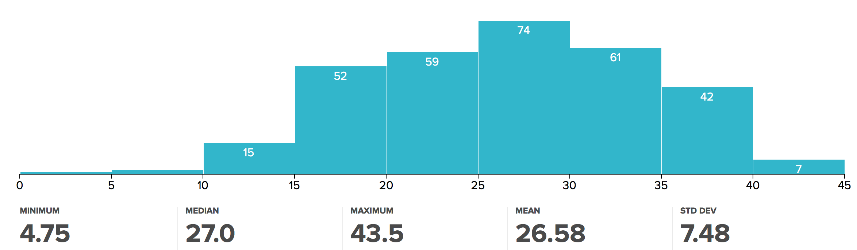
Midterm Notes
Regrades due by Saturday at noon!

Slide 3

CS61BL, Summer 2017
Lecture 5 : Tries, Heaps, and Graphs

Slide 4
Search-by-key Data Structures
Searches using compareTo()
BST
Set
2-3 Tree
RB Tree
Map
Searches using hashCode() and equals()
External Chains
Searches uses … digits?

Slide 5
Tries

Slide 6
Digit-by-digit Search
Suppose we want to insert “sam” and “sad” into our new digit-based data structure
s
a
d
m

Slide 7
Digit-by-digit Search
Suppose we want to insert “sam”, “sad”, “sap”, “same”, “a”, and “awls”
We’ve already inserted “sam” and “sad”
Try and insert the rest!
s
a
d
m

Slide 8
Digit-by-digit Search
Suppose we want to insert “sam”, “sad”, “sap”, “same”, “a”, and “awls”
a
s
a
w
d
m
p
l
e
s

Slide 9
Digit-by-digit Search
Suppose we want to insert “sam”, “sad”, “sap”, “same”, “a”, and “awls”
contains(“sam”): true, green node
contains(“sa”): false, white node
contains(“a”): true, green node
Search “miss” conditions:
The final node is white, or
We fall off the tree (e.g. contains(“z”))
a
s
a
w
d
m
p
l
e
s

Slide 10
Digit-by-digit Search
Suppose we want to insert “sam”, “sad”, “sap”, “same”, “a”, and “awls”
For an animated demo, see this demo.
a
s
a
w
d
m
p
l
e
s

Slide 11
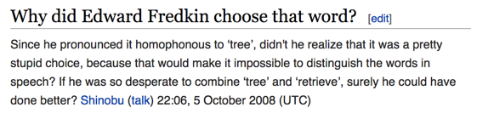
Origin of the Trie
Invented by Edward Fredkin
Short for retrieval tree
Pronounced same as tree
But we’ll pronounce it as “try”, like everyone except its inventor

Slide 12
Tries: A Digit-by-digit Set Representation
a
s
sad
0
1
2
3
sad
sam
awls
w
a
awls
same
a
sap
l
d
m
p
a
sam
sap
same
s
e
BST
Hash Set
Trie

Slide 13
Trie Performance in Terms of N and L shoutkey.com/lease
Given a trie with N keys and a key with L digits, what is the:
Worst case insert runtime?
Worst case search runtime?
Best case search runtime?
Assume child can be found in constant time
Bonus question: how does this performance compare to a hash set?
a
s
w
a
l
d
m
p
s
e

Slide 14
Trie Performance in Terms of N and L
Given a trie with N keys and a key with L digits, what is the:
Worst case insert runtime? Θ(L)
Worst case search runtime? Θ(L)
Best case search runtime? Θ(1)
Hash set (search): Θ(NL) worst case, Θ(L) typical case, Θ(L) best case
a
s
w
a
Corresponds to a miss on the first digit!
l
d
m
p
s
e

Slide 15
Set Data Structures (Raw Performance for Search)
Runtimes for contains()
 | Amortized average | Worst case | Best case
BST (Balanced) |  | Θ(L log N) | Θ(L) (hit)
Trie |  | Θ(L) | Θ(1) (miss)
Hash Set | Θ(L)* | Θ(NL)
N keys, L digits per key. A miss means the key isn’t present.
Performance for tries:
Comparison is done digit-by-digit, allowing us to skip some characters
Hash sets may look at many unnecessary characters, as computing a full hashCode usually requires looking at all characters
Like hash sets, searching is constant with respect to the number of keys

Slide 16
Usages of Tries
Theoretical asymptotic speed improvement is nice, but main appeal of tries is their ability to support rapid prefix matching and approximate matching
Finding all keys that match a given prefix: keysWithPrefix(“sa”)
Find longest prefix of: longestPrefixOf(“sample”)
sad
sad
sam
a
s
0
1
2
3
awls
w
a
awls
same
a
sap
l
d
m
p
sac
sam
sap
same
s
e

Slide 17
Trie Implementation

Slide 18
Trie Implementation
The somewhat counter-intuitive but easiest Java representation of a trie doesn’t store letters inside nodes
Instead, store letters implicitly on each link!
public class TrieSet { // Supports characters up through #128 private static final int R = 128; private class Node { boolean exists;
/* Up to R links */ Node[] links = new Node[R]; public Node() { ... } } private Node root = new Node(); }
a
s
w
a
l
d
m
p
s
e

Slide 19
Trie Implementation
The somewhat counter-intuitive but easiest Java representation of a trie doesn’t store letters inside nodes
Instead, store letters implicitly on each link!
public class TrieSet { // Supports characters up through #128 private static final int R = 128; private class Node { boolean exists;
/* Up to R links */ Node[] links = new Node[R]; public Node() { ... } } private Node root = new Node(); }
a
s
...
w
a
...
...
l
...
...
d
...
...
...

Slide 20
Trie Implementation
public class TrieSet {
/* Supports characters up
through #128 */ static final int R = 128; private class Node { boolean exists;
/* Up to R links */ Node[] links
= new Node[R]; public Node() { ... }
} private Node root
= new Node();
public void put(String key) { put(root, key, 0); } private Node put(Node x, String key, int d){ if (x == null) { x = new Node(); } if (d == key.length()) { x.exists = true; return x; } char c = key.charAt(d); x.links[c] = put(x.links[c], key, d+1); return x; }}
Hideous style due to lack of space

Slide 21
Summary: Tries
Excellent performance, support character-based operations
Naive implementation is extremely memory hungry
Problem: mapping from a node to its children is done with a data-indexed array of size R
Why is that bad? Every node uses R memory... even leaves!
Memory usage can be improved through various optimizations:
More sophisticated child tracking
Ternary search tries

Slide 22
Child Link Optimizations

Slide 23
The Array-based Trie
Each node has R links, where R is the alphabet size
How can we save memory?
public class TrieSet { // Supports characters up through #128 private static final int R = 128; private class Node { boolean exists;
/* Up to R links */ Node[] links = new Node[R]; public Node() { ... } } private Node root = new Node(); }
a
s
...
w
a
...
...
l
...
...
d
...
...
...

Slide 24
The Array-based Trie: a More Accurate Representation
exists:
F
links:
a
c
...
97
98
99
100
...
d
exists:
exists:
F
T
links:
links:
Problem: arrays are ‘sparse’
Can we replace the array with something more space-efficient?
...
97
98
99
100
...
...
97
98
99
100
...
exists:
T
links:
...
97
98
99
100
...

Slide 25
A More Modular TrieSet
Idea: replace the array with a Map
Can switch between HashMap and TreeMap by changing the instantiation of links
private class Node { boolean exists; Map<Character,Node> links; public Node() { links = new TreeMap<Character,Node>(); } }

Slide 26
A More Modular TrieSet
private class Node { boolean exists; Map<Character,Node> links; public Node() { links = new TreeMap<Character,Node>(); } }
Choice of links data structure comes with time/space tradeoff
Data-indexed array: max speed, max memory
TreeMap/HashMap: slower query performance, but less memory wasted

Slide 27
A More Modular Trie
exists:
F
links:
‘c’
a
c
‘a’
d
Much better!
TreeMap solutions wastes essentially no space
exists:
F
exists:
T
links:
links:
‘d’
exists:
T
links:

Slide 28
Ternary Search Tries

Slide 29
Ternary Search Trie: Capping the Links Per Node
A new approach: redesign the trie so that it has a fixed number of links
One approach: the ternary search trie
Assign a character to each node
Give each node 3 links
As we traverse the TST, pick links after comparing the key’s next character to the node’s character
Left link if the key’s next character < the node’s character
Middle link if the key’s next character = the node’s character
Right link if the key’s next character > the node’s character

Slide 30
Ternary Search Trie
After inserting “sam”
s
a
s
a
w
a
m
l
d
m
p
s
e
Standard Trie

Slide 31
Ternary Search Trie
After inserting “sam”, “sad”
s
a
s
a
w
a
m
l
d
m
p
d
s
e
Standard Trie

Slide 32
Ternary Search Trie
After inserting “sam”, “sad”, “sap”
s
a
s
a
w
a
m
l
d
m
p
d
p
s
e
Standard Trie

Slide 33
Ternary Search Trie
After inserting “sam”, “sad”, “sap”, “same”
s
a
s
a
w
a
m
l
d
m
p
d
e
p
s
e
Standard Trie

Slide 34
Ternary Search Trie
After inserting “sam”, “sad”, “sap”, “same”, “a”
s
a
s
a
a
w
a
m
l
d
m
p
d
e
p
s
e
Standard Trie

Slide 35
Ternary Search Trie
After inserting “sam”, “sad”, “sap”, “same”, “a”, and “awls”
s
a
s
a
a
w
a
w
m
l
d
m
p
l
d
e
p
s
e
s
Animated demo
Standard Trie

Slide 36
Ternary Search Trie: Capping the Links Per Node
public class TST { private Node root; private class Node { /* char in this node */ char c; /* left, middle, and right sub-trie links */ Node left, middle, right } }
Full implementation available for your perusal here

Slide 37
Ternary Search Trie Performance
Provide an example of a sequence of insert operations that result in much worse performance that a standard trie

Slide 38
Ternary Search Trie Performance
Provide an example of a sequence of insert operations that result in much worse performance that a standard trie
insert(“A”)
insert(“B”)
insert(“C”)
insert(“D”)
a
b
c
d

Slide 39
Ternary Search Trie Performance
Runtimes for contains()
 | Amortized average | Worst case | Best case (miss) | Memory
Hash Set | Θ(L)* |  |  | Θ(NL)
BST |  | Θ(L log N) | Θ(1) | Θ(NL)
Trie (array map) |  | Θ(L) | Θ(1) | Θ(NLR)
Trie (HashMap) |  | Θ(L) | Θ(1) | Θ(NL)
Trie (TreeMap) |  | Θ(L log R) | Θ(1) | Θ(NL)
TST |  | Θ(NL) | Θ(1) | Θ(NL)

Slide 40
Tries and Ternary Search Tries: Summary
Tries and TSTs provide a performance improvement over previous data structures and support useful character-based operations
Various trie implementations are available
Each comes with memory and time trade-offs
Set
Searches using … digits!
Trie
Map
TST

Slide 41
Break (5 minutes)

Slide 42
Priority Queues

Slide 43
The PriorityQueue ADT
Used to order elements by their priority (a user defined measure of importance)
Could be passed in as a number as done in lab
Could be implicit by having elements be Comparables or by using a Comparator
Optimized operations for getting the head of the queue (which is either the smallest or largest element depending on what the user deems to have high priority)
Implemented using a min (or max) binary heap
Notes:
The priorities create a total ordering on the items we insert into the PQ. (We can use that to sort later!!!)

Slide 44
The PriorityQueue ADT
/** Priority Queue: Allowing tracking and removal of the
* most important item in a priority queue. */
public interface PriorityQueue<E> {
/** Adds the item to the priority queue. */
public void add(E x);
/** Returns the most important item in the priority queue. */
public E peek();
/** Removes and returns the most important item from the
* priority queue. */
public E poll();
/** Returns the size of the priority queue. */
public int size();
}

Slide 45
Why You Should Care: Danger Detector
Imagine that you are a spy sent out to keep track of the world’s criminals
Your job: Intercept the Messages as they are being sent out by the criminals to make sure they’re not trying to make destroy the world.
Every day, you must send a list of the K most suspicious Messages to your boss.
Naive approach: Store all the Messages you intercept for that day. Sort them by their suspiciousness. Return the top K Messages

Slide 46
Naive Implementation: Store and Sort
public List<Message> suspisciousMessages(SpyTracker sniffer, int K) {
List<Message> allMessages = new ArrayList<String>();
for (Timer timer = new Timer(); timer.hours() < 24; ) {
allMessages.add(sniffer.getNextMessage());
}
Collections.sort(allMessages);
return allMessages.sublist(0, M);
}
Potentially uses a huge amount of memory Θ(N), where N is number of Messages.
Goal: Do this in Θ(M) memory using a PriorityQueue.
PriorityQueue<Message> sussMessages = new MinHeap<>();

Slide 47
Better Implementation: Track the K Most Suss
public List<Message> suspisciousMessages(SpyTracker sniffer, int M) {
PriorityQueue<String> sussMessages = new MinHeap<>();
for (Timer timer = new Timer(); timer.hours() < 24; ) {
sussMessages.add(sniffer.getNextMessage());
if (sussMessages.size() > M)
{ sussMessages.poll(); }
}
List<Message> messageList = new ArrayList<>();
while (sussMessages.size() > 0) {
messageList.add(sussMessages.poll());
}
return messageList;
}
Can track top M messages using only M memory.

Slide 48

Heaps

Slide 49
Introducing the Heap
Binary min-heap: Binary tree that is complete and obeys min-heap property.
Min-heap: Every node is less than or equal to all of its descendants (This means the root holds the min element.
Complete: Every level is completely filled except for the lowest level, and the lowest level is filled from left to right.
0
0
0
0
0
5
1
5
1
5
1
5
1
8
8
6
2
8
8
6
8
8
2
8
4
6
Incomplete
Lacks min-heap property

Slide 50
Heap Comprehension Test: http://shoutkey.com/viridian
How many of these are min heaps?
0
1
2
3
4
8
5
4
0
8
8
6
2
7
1
8
8
8
7
8
0
3
5
9

Slide 51
Heap Comprehension Test
How many of these are min heaps?
0
1
2
3
4
8
5
4
0
8
8
6
2
7
1
8
8
8
7
8
0
3
5
9
Incomplete
Lacks min-heap property

Slide 52
Typical Representation of a Heap
We could use a Node class...
1
3
5
7
4
6
8

Slide 53
Typical Representation of a Heap
We could use a Node class...
Or we can use an array to store the items
Take advantage of the completeness of the tree
Uses less memory
Index 0 will be unused to simplify calculations
1
3
5
7
4
6
8
1
3
5
7
4
6
8

Slide 54
A Heap of Brain Teasers
Is there any relationship between two nodes a, b where a ≠ b, a is not a descendant of b and b is not a descendant of a?
1
3
5
7
4
6
8
1
3
5
7
4
6
8

Slide 55
A Heap of Brain Teasers
Is there any relationship between two nodes a, b where a ≠ b, a is not a descendant of b and b is not a descendant of a? No.
1
3
5
7
4
6
8
1
3
5
7
4
6
8

Slide 56
A Heap of Brain Teasers
Is there any relationship between two nodes a, b where a ≠ b, a is not a descendant of b and b is not a descendant of a? No.
For a binary heap, if a node is at index i of the array, what indices are its children/parent located at?
1
3
5
7
4
6
8
1
3
5
7
4
6
8

Slide 57
A Heap of Brain Teasers
Is there any relationship between two nodes a, b where a ≠ b, a is not a descendant of b and b is not a descendant of a? No.
For a binary heap, if a node is at index i of the array, what indices are its children/parent located at?
children: 2i, 2i + 1
parent: i/2
1
3
5
7
4
6
8
1
3
5
7
4
6
8

Slide 58
A Heap of Brain Teasers
Is there any relationship between two nodes a, b where a ≠ b, a is not a descendant of b and b is not a descendant of a? No.
For a binary heap, if a node is at index i of the array, what indices are its children/parent located at?
children: 2i, 2i + 1
parent: i/2
Indices for node at index i in a k-ary heap (where each node has k children)? Assume first heap element is at index 0.
1
3
5
7
4
6
8
1
3
5
7
4
6
8

Slide 59
A Heap of Brain Teasers
Is there any relationship between two nodes a, b where a ≠ b, a is not a descendant of b and b is not a descendant of a? No.
For a binary heap, if a node is at index i of the array, what indices are its children/parent located at?
children: 2i, 2i + 1
parent: i/2
Indices for node at index i in a k-ary heap (where each node has k children)? Assume first heap element is at index 0.
children: ki + 1, ki + 2, …, ki + k
parent: (i-1)/k
1
3
5
7
4
6
8
1
3
5
7
4
6
8

Slide 60
Binary Heap: add(E element)
Place the element in the next open spot in the array (leftmost open spot in the last row of the heap).
Swap elements upwards (by comparing the added element with parent elements) until the heap invariants are satisfied (bubbleUp).
7

Slide 61
Binary Heap: add(E element)
Place the element in the next open spot in the array (leftmost open spot in the last row of the heap).
Swap elements upwards (by comparing the added element with parent elements) until the heap invariants are satisfied (bubbleUp).
add(5)
7
7
5

Slide 62
Binary Heap: add(E element)
Place the element in the next open spot in the array (leftmost open spot in the last row of the heap).
Swap elements upwards (by comparing the added element with parent elements) until the heap invariants are satisfied (bubbleUp).
add(5)
7
7
5
5
7

Slide 63
Binary Heap: add(E element)
Place the element in the next open spot in the array (leftmost open spot in the last row of the heap).
Swap elements upwards (by comparing the added element with parent elements) until the heap invariants are satisfied (bubbleUp).
add(5)
add(3)
7
7
5
5
5
7
7
3

Slide 64
Binary Heap: add(E element)
Place the element in the next open spot in the array (leftmost open spot in the last row of the heap).
Swap elements upwards (by comparing the added element with parent elements) until the heap invariants are satisfied (bubbleUp).
add(5)
add(3)
7
7
5
5
3
5
7
7
3
7
5

Slide 65
Binary Heap: add(E element)
3
What happens if we call add(4) and then add(1)?
7
5

Slide 66
Binary Heap: add(E element)
3
What happens if we call add(4) and then add(1)?
7
5
add(4)
3
7
5
4

Slide 67
Binary Heap: add(E element)
3
What happens if we call add(4) and then add(1)?
7
5
add(4)
3
3
7
5
4
5
4
7

Slide 68
Binary Heap: add(E element)
add(1)
3
3
What happens if we call add(4) and then add(1)?
7
5
4
5
add(4)
7
1
3
3
7
5
4
5
4
7

Slide 69
Binary Heap: add(E element)
add(1)
3
3
3
What happens if we call add(4) and then add(1)?
7
5
4
5
1
5
add(4)
7
1
7
4
3
3
7
5
4
5
4
7

Slide 70
Binary Heap: add(E element)
add(1)
3
3
3
What happens if we call add(4) and then add(1)?
7
5
4
5
1
5
add(4)
7
1
7
4
3
3
1
7
5
4
5
3
5
4
7
7
4

Slide 71
Binary Heap: poll()
Swap the root with the last element in the array (rightmost filled spot in the last row of the heap).
Swap elements downwards (by comparing the new root element with its children) until the heap invariants are satisfied (bubbleDown).
poll()
3
5
7

Slide 72
Binary Heap: poll()
Swap the root with the last element in the array (rightmost filled spot in the last row of the heap).
Swap elements downwards (by comparing the new root element with its children) until the heap invariants are satisfied (bubbleDown).
poll()
3
7
5
7
5
3

Slide 73
Binary Heap: poll()
Swap the root with the last element in the array (rightmost filled spot in the last row of the heap).
Swap elements downwards (by comparing the new root element with its children) until the heap invariants are satisfied (bubbleDown).
poll()
3
7
5
5
7
5
3
7

Slide 74
Binary Heap: poll()
Swap the root with the last element in the array (rightmost filled spot in the last row of the heap).
Swap elements downwards (by comparing the new root element with its children) until the heap invariants are satisfied (bubbleDown).
poll()
poll()
3
7
5
5
5
7
5
3
7
7

Slide 75
Binary Heap: poll()
Swap the root with the last element in the array (rightmost filled spot in the last row of the heap).
Swap elements downwards (by comparing the new root element with its children) until the heap invariants are satisfied (bubbleDown).
poll()
poll()
3
7
5
5
7
7
5
7
5
3
7
7
5

Slide 76
Binary Heap: poll()
1
3
5
7
4
What happens if we call poll() twice?

Slide 77
Binary Heap: poll()
1
poll()
1
3
5
3
5
7
4
7
4
What happens if we call poll() twice?

Slide 78
Binary Heap: poll()
1
poll()
1
4
3
5
3
5
3
5
7
4
7
4
7
1
What happens if we call poll() twice?

Slide 79
Binary Heap: poll()
1
poll()
1
4
3
3
5
3
5
3
5
4
5
7
4
7
4
7
1
7
What happens if we call poll() twice?

Slide 80
Binary Heap: poll()
1
poll()
1
4
3
3
5
3
5
3
5
4
5
7
4
7
4
7
1
7
What happens if we call poll() twice?
poll()
3
4
5
7

Slide 81
Binary Heap: poll()
1
poll()
1
4
3
3
5
3
5
3
5
4
5
7
4
7
4
7
1
7
What happens if we call poll() twice?
poll()
3
7
4
5
4
5
7
3

Slide 82
Binary Heap: poll()
1
poll()
1
4
3
3
5
3
5
3
5
4
5
7
4
7
4
7
1
7
What happens if we call poll() twice?
poll()
3
7
4
4
5
4
5
7
5
7
3

Slide 83
Worst-case runtime of heap operations
Operation | Description | Runtime for binary heap
add(E element) | 1. Place the element in the next open spot in the array. 2. Swap elements upwards (by comparing the new element with its parent) until valid heap.
peek() | Access the root
poll() | 1. Swap the root with the last element in the array. 2. Swap elements downwards (by comparing the new root with its children) until valid heap.

Slide 84
Worst-case runtime of heap operations
Operation | Description | Runtime for binary heap
add(E element) | 1. Place the element in the next open spot in the array. 2. Swap elements upwards (by comparing the new element with its parent) until valid heap. | 1. ϴ(1) 2. ϴ(log N) Total: ϴ(log N)
peek() | Access the root
poll() | 1. Swap the root with the last element in the array. 2. Swap elements downwards (by comparing the new root with its children) until valid heap.

Slide 85
Worst-case runtime of heap operations
Operation | Description | Runtime for binary heap
add(E element) | 1. Place the element in the next open spot in the array. 2. Swap elements upwards (by comparing the new element with its parent) until valid heap. | 1. ϴ(1) 2. ϴ(log N) Total: ϴ(log N)
peek() | Access the root | ϴ(1)
poll() | 1. Swap the root with the last element in the array. 2. Swap elements downwards (by comparing the new root with its children) until valid heap.

Slide 86
Worst-case runtime of heap operations
Operation | Description | Runtime for binary heap
add(E element) | 1. Place the element in the next open spot in the array. 2. Swap elements upwards (by comparing the new element with its parent) until valid heap. | 1. ϴ(1) 2. ϴ(log N) Total: ϴ(log N)
peek() | Access the root | ϴ(1)
poll() | 1. Swap the root with the last element in the array. 2. Swap elements downwards (by comparing the new root with its children) until valid heap. | 1. ϴ(1) 2. ϴ(log N) Total: ϴ(log N)

Slide 87
Heapify
Naive approach of creating a heap of size N
N calls to add, each of which takes ϴ(log N) (sort of)
Total runtime: ϴ(N log N)
Can we do better?
Yes, we can heapify an array into an heap.
Total runtime: ϴ(N) [Proof in extra slides at the end]

Slide 88
Heapify
7
4
6
8
1
3
5
Start with an input array.
Begin at the middle index of the array (first node with children).
Do the following at index i:
Check that the ith element is smaller than its children to satisfy the heap invariant.
If necessary, swap the ith element with its smallest child and repeat step 3 for the child index that the element was swapped into (bubbleDown).
If the ith index is not the root, repeat step 3 for index i - 1.
1
4
3
8
7
6
5
1
4
3
8
7
6
5

Slide 89
Heapify
7
4
6
8
1
3
5
7
4
6
8
1
3
5

Slide 90
Heapify
7
4
6
8
1
3
5
7
4
6
8
1
3
5

Slide 91
Heapify
7
4
3
8
1
6
5
7
7
4
6
4
3
8
1
3
5
8
1
6
5

Slide 92
Heapify
7
4
3
8
1
6
5
7
7
4
6
4
3
8
1
3
5
8
1
6
5

Slide 93
Heapify
7
7
3
3
8
8
6
4
6
1
1
4
5
5
7
7
7
4
6
4
3
1
3
8
1
3
5
8
1
6
5
8
4
6
5

Slide 94
Heapify
7
7
7
3
3
3
8
8
8
6
6
4
6
4
1
1
1
4
5
5
5
7
7
7
4
6
4
3
1
3
8
1
3
5
8
1
6
5
8
4
6
5

Slide 95
Heapify
7
7
7
7
1
7
7
7
1
3
3
3
3
3
3
3
3
3
8
8
8
8
8
8
8
8
8
6
6
6
6
6
6
6
6
4
6
4
4
4
4
4
4
4
7
1
1
1
1
7
1
1
1
4
5
5
5
5
5
5
5
5
5
7
7
7
4
6
4
3
1
3
8
1
3
5
8
1
6
5
8
4
6
5
1
7
3
8
4
6
5

Slide 96
Heapify
7
7
7
7
1
3
3
3
3
3
8
8
8
8
8
6
6
6
6
4
6
4
4
4
4
1
1
1
1
7
5
5
5
5
5
7
7
7
4
6
4
3
1
3
8
1
3
5
8
1
6
5
8
4
6
5
1
1
7
3
4
3
8
4
6
5
8
7
6
5

Slide 97
Heapify
7
7
7
7
7
1
3
3
3
3
3
3
8
8
8
8
8
8
6
6
6
6
6
4
6
4
4
4
4
4
1
1
1
1
1
7
5
5
5
5
5
5
7
7
7
4
6
4
3
1
3
8
1
3
5
8
1
6
5
8
4
6
5
1
1
7
3
4
3
8
4
6
5
8
7
6
5

Slide 98
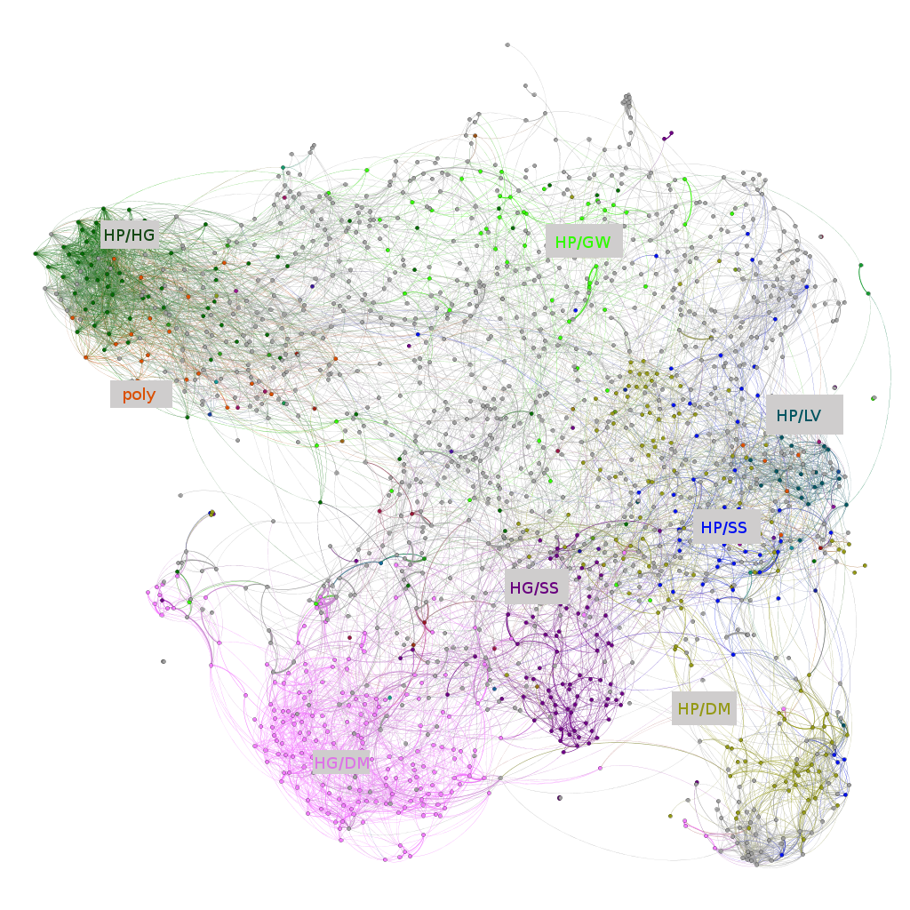
Graphs

Slide 99
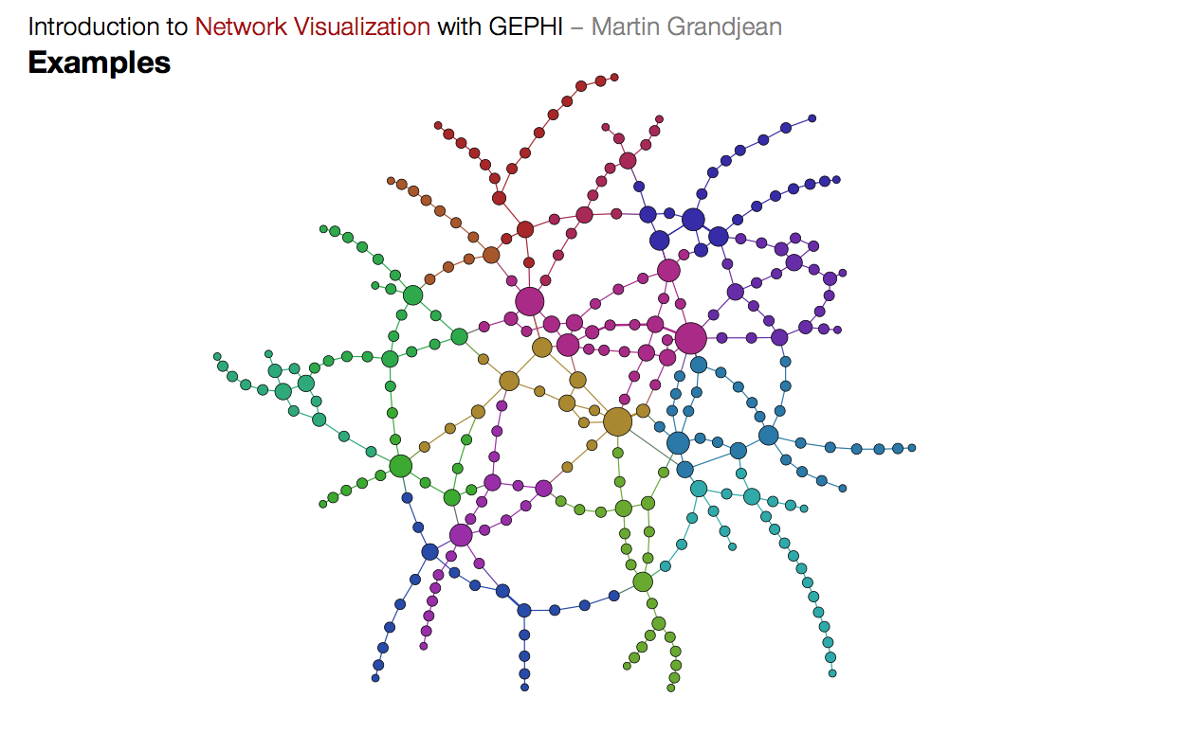
Terminology
Definition: A graph G = (V, E) is:
A set of vertices V (also called nodes interchangably)
Typically represented as integers in memory
A set of edges E, where e=(v₁,v₂) ∈ E

Slide 100
Flavors of Graphs
Directed
Undirected
b
b
e
Edge Labels/Weights
Acyclic:
a
d
a
d
b
3
e
c
c
1
1
a
d
2
b
b
c
Cyclic:
a
d
a
d
c
c

Slide 101
More Terminology
A directed edge (v, w) is a path from v to w, but not from w to v. An undirected edge goes both ways.
We secretly use simple graphs. No self edges (v, v) or multi-edges (more than one edge (u, v).

Slide 102
Graphs: Metrics
Path - sequence of vertices, each adjacent pair is connected by an edge.
Length of the path: number of edges traversed.
If weighted, sum of the weights along the edges traversed.
Distance from u to v: dist(u, v) = length of shortest path from u to v.
A cycle is a path whose first and last vertices are the same.
A graph with a cycle is ‘cyclic’.
Strongly connected - there exists some path between each pair of vertices (defined for directed graphs).
Connected if a undirected graph.
Degree - the number of edges connected to a vertex.
Indegree & Outdegree for directed graphs.

Slide 103
Some Graph-Processing Problems
s-t Path. Is there a path between vertices s and t?
Shortest s-t Path. What is the shortest path between vertices s and t?
Cycle. Does the graph contain any cycles?
Euler Tour. Is there a cycle that uses every edge exactly once?
Hamilton Tour. Is there a cycle that uses every vertex exactly once?
Connectivity. Is the graph connected, i.e. is there a path between all vertex pairs?
Biconnectivity. Is there a vertex whose removal disconnects the graph?
Planarity. Can you draw the graph on a piece of paper with no crossing edges?
Isomorphism. Are two graphs isomorphic (the same graph in disguise)?
Graph problems: Unobvious which are easy, hard, or computationally intractable.

Slide 104
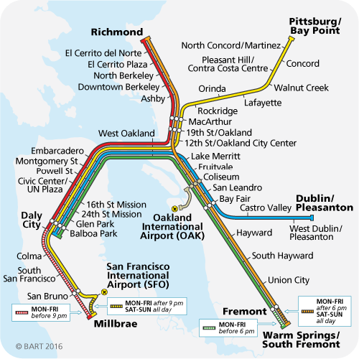
Graph Example: BART
Notes:
bart.gov

Slide 105

Nodes: Cities. Edge Weights: ~Number of friends between cities

Slide 106
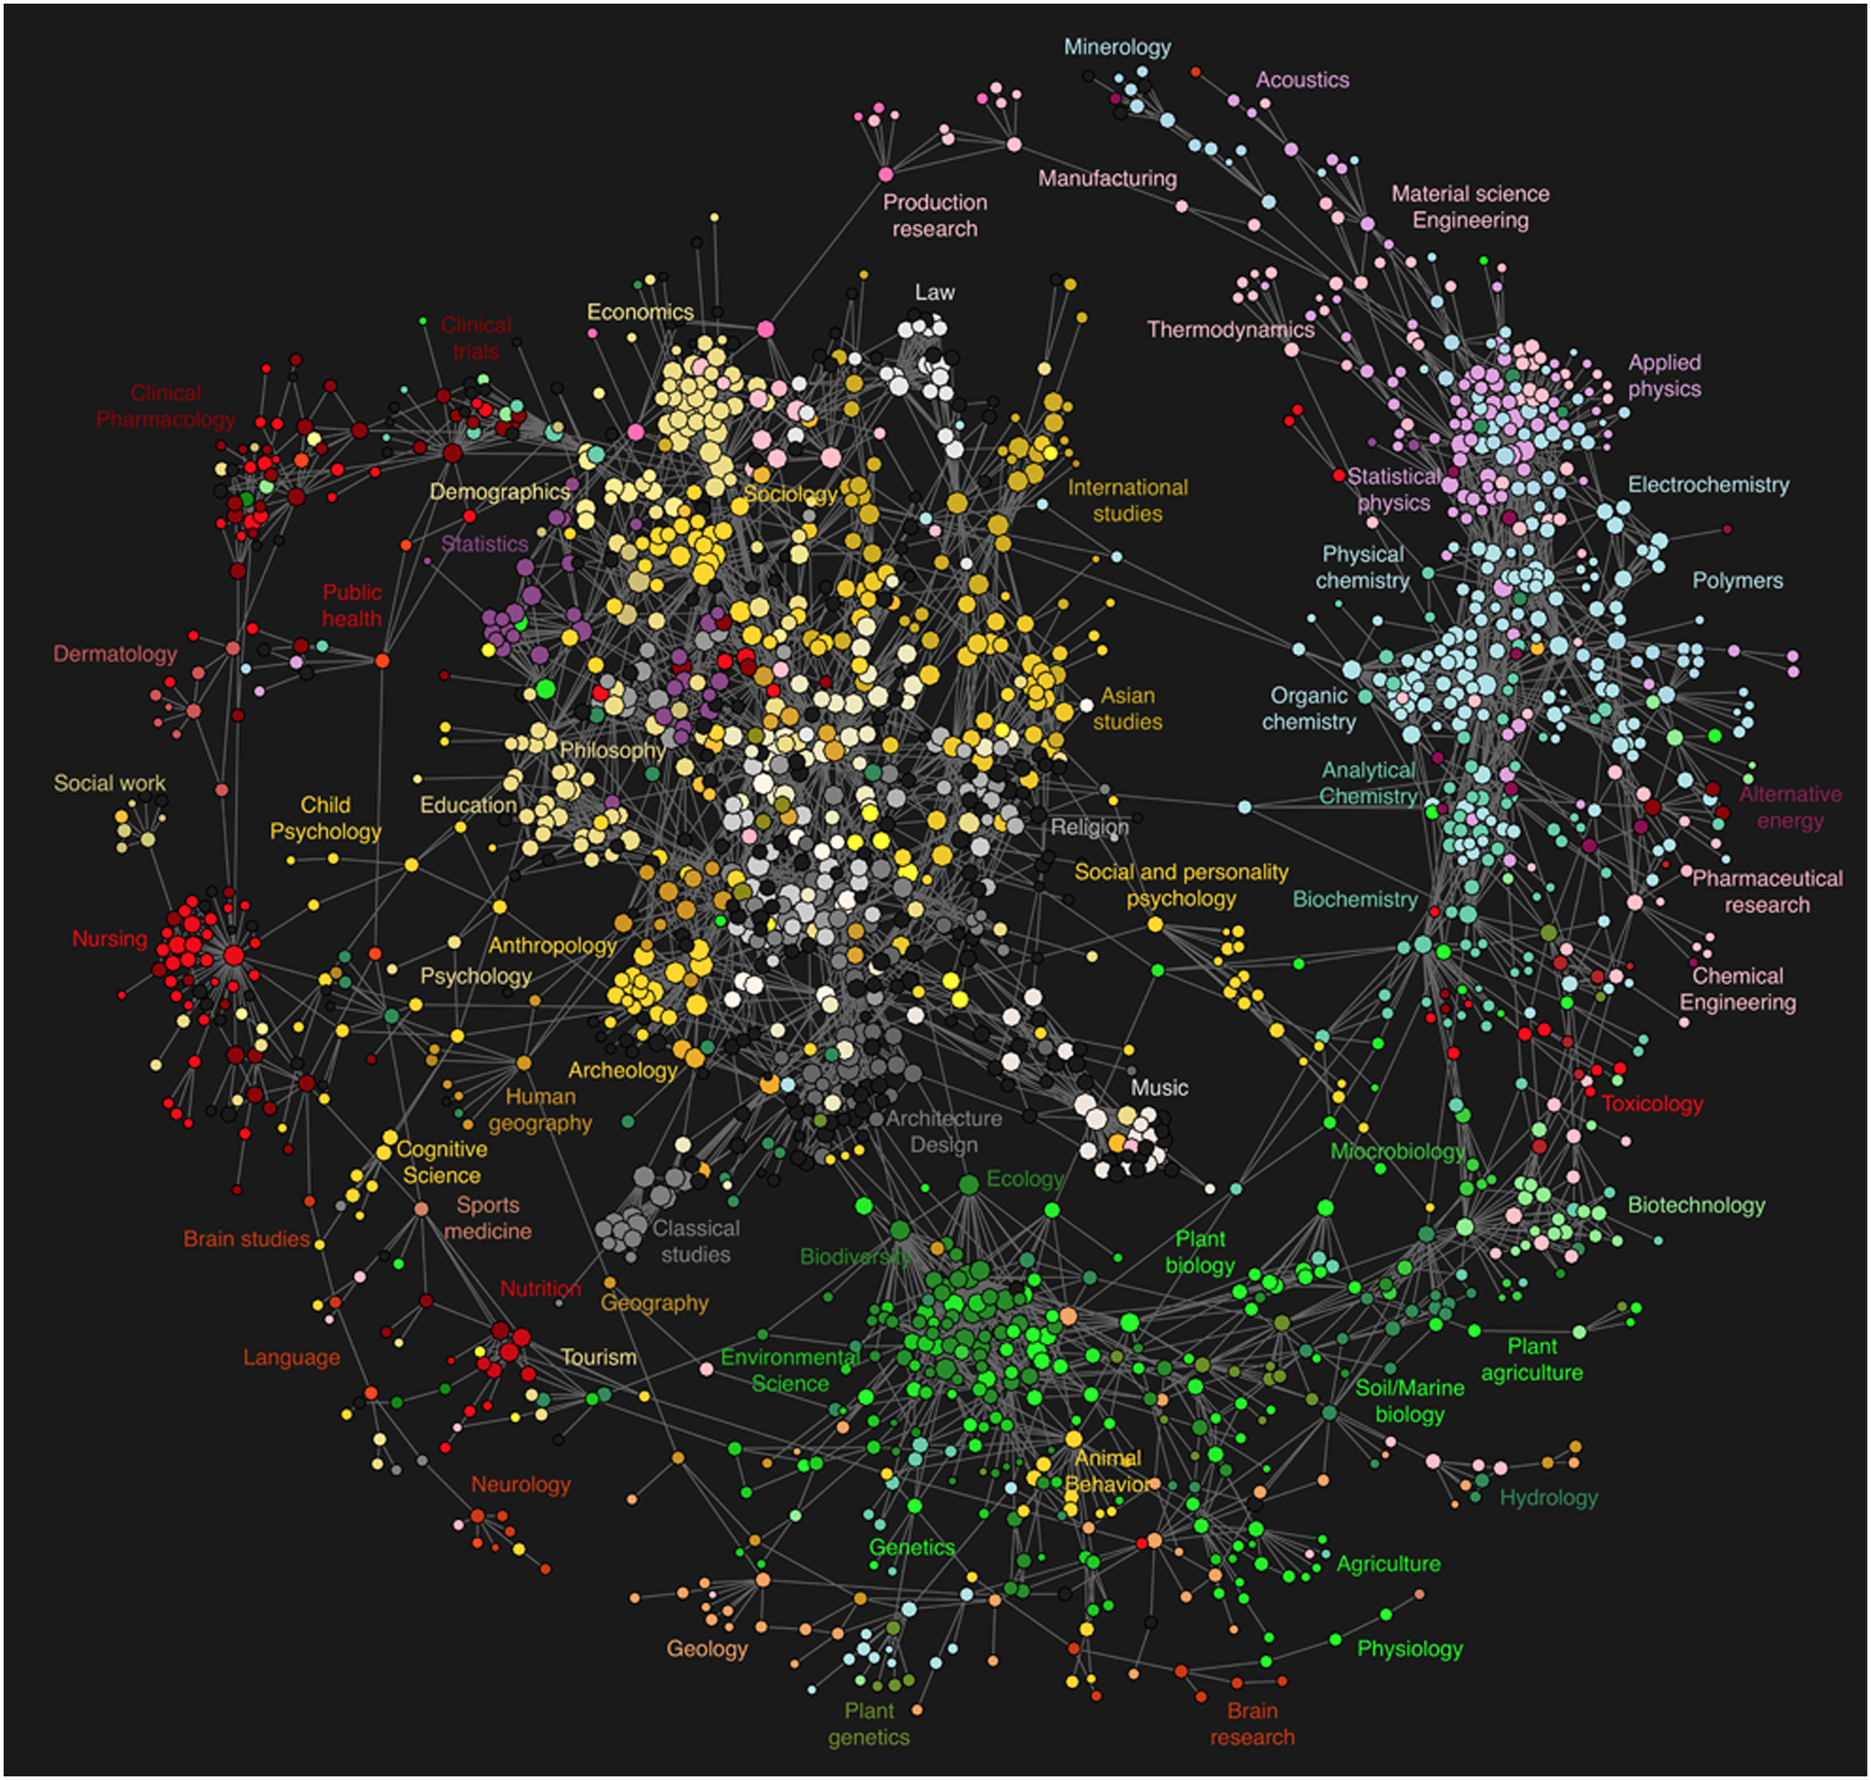
Nodes: Scientific Journals.
Label: AAT classification (the topic that it covers)
Edges:
Based on clickthrough data.
Clickthrough from v to w means that someone reading an article in journal v clicked on a link to an article in journal w.
Edge assigned from v to w if clickthrough rate from v to w is above some arbitrary threshold.
Notes:
http://www.plosone.org/article/info:doi/10.1371/journal.pone.0004803

Slide 107
Graph Representations

Slide 108
Graph Representations
Representation 1: Adjacency Matrix.
t
1
 | 0 | 1 | 2
0 | 0 | 1 | 1
1 | 0 | 0 | 1
2 | 0 | 0 | 0
For undirected graph: Each edge is represented twice in the matrix. Simplicity at the expense of space.
s
0
2
w
 | 0 | 1 | 2 | 3
0 | 0 | 1 | 0 | 0
1 | 1 | 0 | 1 | 0
2 | 0 | 1 | 0 | 1
3 | 0 | 0 | 1 | 0
v
1
0
2
3

Slide 109
Graph Representations
Representation 1: Adjacency Matrix.
t
1
 | 0 | 1 | 2
0 | 0 | 1 | 1
1 | 0 | 0 | 1
2 | 0 | 0 | 0
From the structure, we see that |E| ≤ |V|²
Θ(1) edge add / removal
Θ(1) edge exists check
Θ(|V|) find adjacent edges
Θ(|V|) get outdegree.
s
0
2
w
 | 0 | 1 | 2 | 3
0 | 0 | 1 | 0 | 0
1 | 1 | 0 | 1 | 0
2 | 0 | 1 | 0 | 1
3 | 0 | 0 | 1 | 0
v
1
0
2
3
Notes:
All times are worst-case

Slide 110
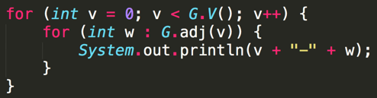
Graph Printing Runtime: http://shoutkey.com/pierce
Bound the runtime of the following code if the graph uses an adjacency-matrix representation, where V is the number of vertices, and E is the total number of edges?
Θ(|V|)
Θ(|V| + |E|)
Θ(|V|²)
Θ(|V|*|E|)
How much time does adj take?
How many adj calls?
 | 0 | 1 | 2 | 3
0 | 0 | 1 | 0 | 0
1 | 1 | 0 | 1 | 0
2 | 0 | 1 | 0 | 1
3 | 0 | 0 | 1 | 0
1
0
2
3

Slide 111
Graph Printing Runtime
What is the order of growth of the running time of the following code if the graph uses an adjacency-matrix representation, where V is the number of vertices, and E is the total number of edges.
Θ(|V|)
Θ(|V| + |E|)
Θ(|V|²)
Θ(|V|*|E|)
How much time does adj take?
Θ(|V|) worst case.
How many adj calls?
Θ(|V|) calls.
 | 0 | 1 | 2 | 3
0 | 0 | 1 | 0 | 0
1 | 1 | 0 | 1 | 0
2 | 0 | 1 | 0 | 1
3 | 0 | 0 | 1 | 0
1
0
2
3

Slide 112
Another Graph Representation
Representation 2: Adjacency lists.
Common approach: Maintain array of lists indexed by vertex number.
Each vertex has a list of outgoing edges associated with it.
Most popular approach for representing graphs.
1
0
1
2
[1, 2]
[2]
0
2

Slide 113
More Graph Representations
Representation 2: Adjacency lists.
Common approach: Maintain array of lists indexed by vertex number.
Each vertex has a list of outgoing edges associated with it.
Most popular approach for representing graphs.
1
0
2
0
1
2
[1, 2]
Θ(1) get outdegree
Θ(1) to add an edge
Θ(d) find adjacent edges
d is degree of vertex
If sparse, faster to find edges
Θ(|V|) to remove an edge
Θ(|V|) to check if an edge exists
[2]
Notes:
All runtimes are in the worst case

Slide 114
Graph Printing Runtime: http://shoutkey.com/broccoli
Bound the runtime of the following code if the graph uses an adjacency-list representation, where V is the number of vertices, and E is the total number of edges?
Θ(|V|)
Θ(|V| + |E|)
Θ(|V|²)
Θ(|V|*|E|)
How much time does adj take?
Θ(1), G.adj(1), we just return the list itself!
How many adj calls?
Θ(|V|)
b
0
1
2
[1, 2]
a
[2]
c

Slide 115
Graph Printing Runtime
Bound the runtime of the following code if the graph uses an adjacency-list representation, where V is the number of vertices, and E is the total number of edges?
Θ(|V|)
Θ(|V| + |E|)
Θ(|V|²)
Θ(|V|*|E|)
How many times do we print: Θ(E)
b
0
1
2
[1, 2]
[2]
a
c

Slide 116
Graph Printing Runtime:
Bound the runtime of the following code if the graph uses an adjacency-list representation, where V is the number of vertices, and E is the total number of edges?
Θ(|V|)
Θ(|V| + |E|)
Θ(|V|²)
Θ(|V|*|E|)
b
0
1
2
[1, 2]
[2]
a
c

Slide 117
Graph Algorithms

Slide 118
Recursive DFS
Similar to a pre-order tree traversal (we can also define a post-order DFS)
Because of cycles, we must keep a visited set
void dfs(Vertex v) {
v.visit(); // Do something
v.visited = true;
for (Vertex c : v.adjacent) {
if (!c.visited) {
dfs(c);
}
}
}
Note that this defines DFS on a vertex. DFS on a graph calls this on each vertex (which is how we would cover an entire graph if it was not fully connected)

Slide 119
Graph Algorithms: DFS Traversal Example
Choose arbitrary ordering of visiting: Alphabetical for example.
Start with Albany.
Blue is currently visiting, Green is visited.
Albany
LBNL
Treasure Island
Berkeley
SF
Emeryville
Rockridge

Slide 120
Graph Algorithms: DFS Traversal Example
Albany
LBNL
Treasure Island
Berkeley
SF
Emeryville
Rockridge

Slide 121
Graph Algorithms: DFS Traversal Example
Albany
LBNL
Treasure Island
Berkeley
SF
Emeryville
Rockridge

Slide 122
Graph Algorithms: DFS Traversal Example
Albany
LBNL
Treasure Island
Berkeley
SF
Emeryville
Rockridge

Slide 123
Graph Algorithms: DFS Traversal Example
Albany
LBNL
Treasure Island
Berkeley
SF
Emeryville
Rockridge

Slide 124
Graph Algorithms: DFS Traversal Example
Albany
LBNL
Treasure Island
Berkeley
SF
Emeryville
Rockridge

Slide 125
Graph Algorithms: DFS Traversal Example
Runtime: ϴ(|V|+|E|). Visit each node and edge once.
ϴ(|V|²) if using matrix.
Albany
LBNL
Treasure Island
Berkeley
SF
Emeryville
Rockridge

Slide 126
DFS: http://shoutkey.com/smear
2
0
3
5
1
4
6
7
In what order are vertices visited when we do dfs(0)? If you have multiple adjacent vertices, visit the lower number first.
0 1 3 4 7
7 4 3 1 0
7 4 1 0 3
7 4 1 3 0
0 1 4 7 3

Slide 127
DFS
2
0
3
5
1
4
6
7
What order are vertices visited, if we do dfs(0)? If you have multiple adjacents, visit the lower number first.
0 1 3 4 7
7 4 3 1 0
7 4 1 0 3
7 4 1 3 0
0 1 4 7 3

Slide 128
Fringe-Based Traversals
Just as with trees, we can use a fringe to help us keep track of which vertex to go to next, resulting in an iterative algorithm.
Depending on the data structure we choose for the fringe, we get a different traversal algorithm!!
Spoiler alert: 4 algorithms for 1 pseudocode!

Slide 129
Fringe-Based Traversals: Pseudocode
void traverse(Vertex start) {
Fringe<Vertex> fringe = ???
Set<Vertex> visited = new Set();
fringe.add(start); // initialization
while (!fringe.isEmpty()) {
Vertex v = fringe.pop();
if (!visited.contains(v) { //to prevent going in cycles
visit(v); // do something with v
visited.add(v); //mark v as visited
for (Vertex c : v.adjacent) {
fringe.push(c);
}
}
}
}

Slide 130
Fringe-Based Traversals
Choice of Fringe
Stack -> DFS
Queue -> BFS
Priority Queue -> Dijkstras (or A*)
Note: The visit method is powerful and does the actual computations on the graph (such as relaxation for Dijkstras)
There are alternative ways to structuring the code
Putting visited checks inside the for loop over adjacent vertices
Storting booleans in the vertices instead of a Set

Slide 131
Graph Algorithms: Breadth-First Search
Depth first tries to go as deep as possible; breadth-first goes as wide as possible, like peeling an onion.
Visit everything at 1 distance, then 2, then 3, etc.
Finds the shortest path in an unweighted graph
Runtime of BFS is the same as DFS
Albany
LBNL
Berkeley
Emeryville
Rockridge
Treasure Island
Oakland
SF
Alameda
San Leandro

Slide 132
Graph Algorithms: Dijkstra’s Algorithm
Albany
Given that our edges now have weights, BFS no longer finds the shortest path. Example: Emeryville to Albany.
Solution: Use a Priority Queue, ordered on path distance, using edge weights, from the start vertex.
Only update this path distance, d(s, v), if we find a shorter path through the node currently visiting: d(s, u) + d(u, v). This will be done in the visit call.
The above computation is sometimes referred to relaxing an edge. Can only shorten the distance.
2
LBNL
3
6
Berkeley
1
3
Emeryville
Rockridge
5

Slide 133
Graph Algorithms: Dijkstra’s Algorithm
Albany
Requires a bit more setup than standard traversal algorithm to keep track of distances/where you came from
Dijkstra’s finds the shortest path from a start vertex to every other vertex
When a vertex is removed from the fringe, it will be the at its shortest distance
2
LBNL
3
6
Berkeley
1
3
Emeryville
Rockridge
5

Slide 134
Dijkstra’s Algorithm: Runtime
Priority Queue operation count, assuming binary heap based PQ:
Insertions: |V|, each costing O(log V) time.
Delete-min: |V|, each costing O(log V) time.
decreasePriority: |E|, each costing O(log V) time. (Need to map vertex to position in PQ to do this efficiently)
Worst case runtime: Θ((|V| + |E|) lg |V|)
For a connected graph, can be simplified to Θ(|E| lg |V|) because a connected graph needs at least |V| - 1 edges, so there will be many more edges than vertices

Slide 135
Citations
Trie slides derived from Josh Hug’s offering of CS 61B
Heap and Graph slides derived from Alan Yao & Sarah Kim’s offering of CS 61BL as well as Josh Hug’s offering of CS 61B

Slide 136
Extra Slides
For your intellectual pleasure (i.e not tested)

Slide 137
Worst-Case Heapify Runtime Proof
Legend
h height of tree
level 0
level # | # of nodes in level | height of node* | total work for level
level 1
...
...
...
level h-1
...
level h

Slide 138
Worst-Case Heapify Runtime Proof
Legend
h height of tree
level 0
level # | # of nodes in level | height of node* | total work for level
0
1
...
h-1
h
level 1
...
...
...
level h-1
...
level h

Slide 139
Worst-Case Heapify Runtime Proof
Legend
h height of tree
level 0
level # | # of nodes in level | height of node* | total work for level
0 | 2⁰
1 | 2¹
... | ...
h-1 | 2^{h-1}
h | 2^{h}
level 1
...
...
...
level h-1
...
level h

Slide 140
Worst-Case Heapify Runtime Proof
Legend
h height of tree
level 0
level # | # of nodes in level | height of node* | total work for level
0 | 2⁰
1 | 2¹
... | ...
h-1 | 2^{h-1}
h | 2^{h}
level 1
...
...
...
level h-1
...
level h
*Why do we care about the height of the nodes?
This is equal to the max # of swaps to move the node into the correct position (at the bottom).

Slide 141
Worst-Case Heapify Runtime Proof
Legend
h height of tree
level 0
level # | # of nodes in level | height of node* | total work for level
0 | 2⁰ | h
1 | 2¹ | h-1
... | ... | ...
h-1 | 2^{h-1} | 1
h | 2^{h} | 0
level 1
...
...
...
level h-1
...
level h
*Why do we care about the height of the nodes?
This is equal to the max # of swaps to move the node into the correct position (at the bottom).

Slide 142
Worst-Case Heapify Runtime Proof
Legend
h height of tree
level 0
level # | # of nodes in level | height of node* | total work for level
0 | 2⁰ | h | 2⁰(h)
1 | 2¹ | h-1 | 2¹(h-1)
... | ... | ... | ...
h-1 | 2^{h-1} | 1 | 2^{h-1}(1)
h | 2^{h} | 0 | 2^{h}(0)
level 1
...
...
...
level h-1
...
level h
*Why do we care about the height of the nodes?
This is equal to the max # of swaps to move the node into the correct position (at the bottom).

Slide 143

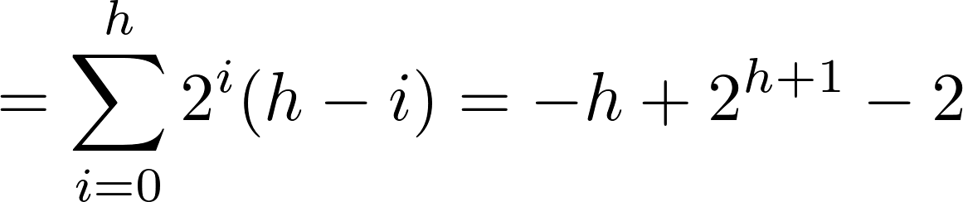
Worst-Case Heapify Runtime Proof
Legend
h height of tree
level # | # of nodes in level | height of node* | total work for level
0 | 2⁰ | h | 2⁰(h)
1 | 2¹ | h-1 | 2¹(h-1)
... | ... | ... | ...
h-1 | 2^{h-1} | 1 | 2^{h-1}(1)
h | 2^{h} | 0 | 2^{h}(0)
*Why do we care about the height of the nodes?
This is equal to the max # of swaps to move the node into the correct position (at the bottom).

Slide 144
Worst-Case Heapify Runtime Proof
Legend
h height of tree
level # | # of nodes in level | height of node* | total work for level
0 | 2⁰ | h | 2⁰(h)
1 | 2¹ | h-1 | 2¹(h-1)
... | ... | ... | ...
h-1 | 2^{h-1} | 1 | 2^{h-1}(1)
h | 2^{h} | 0 | 2^{h}(0)
How? WolframAlpha :3
*Why do we care about the height of the nodes?
This is equal to the max # of swaps to move the node into the correct position (at the bottom).

Slide 145
Worst-Case Heapify Runtime Proof
Legend
h height of tree
Recall that h = log₂n.
T(n) = -log n + 2(2^{log} ^{n}) - 2 = 2n - log n - 2 = ϴ(n)
level # | # of nodes in level | height of node* | total work for level
0 | 2⁰ | h | 2⁰(h)
1 | 2¹ | h-1 | 2¹(h-1)
... | ... | ... | ...
h-1 | 2^{h-1} | 1 | 2^{h-1}(1)
h | 2^{h} | 0 | 2^{h}(0)
How? WolframAlpha :3
*Why do we care about the height of the nodes?
This is equal to the max # of swaps to move the node into the correct position (at the bottom).

